Slide 1



Default Classification
PREDICTING WHETHER AN OBLIGOR DEFAULTS
ANDREW SIQUEIRA

Slide 2
Features
X1
X2
X3
X4
X5
X6
X7
X8
X9
X10
X11
X12
X13
X14
X15

Slide 3
Target
DEFAULT INDICATOR
Value Assigned to 0: Customer is NOT in Default
Value Assigned to 1: Customer is in Default

Slide 4
Method Used to Fill in NULL Values
There were 2000 missing values in ENTIRE Dataset
There were 1000 NULL values in X2 and 1000 NULL values in X4 columns
Implemented method of LINEAR INTERPOLATION with GROUP_BY of the categorical columns (X1, X13, X14, X15, PD_RISK_RATING)
Repeated method for ENTIRE Dataset

Slide 5
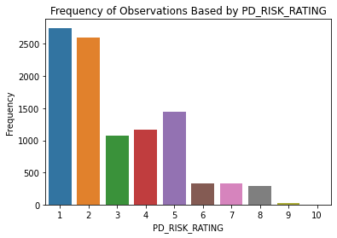
Categories of PD Risk Rating
The top risk ratings of Customers that appears to be more prevalent

Slide 6
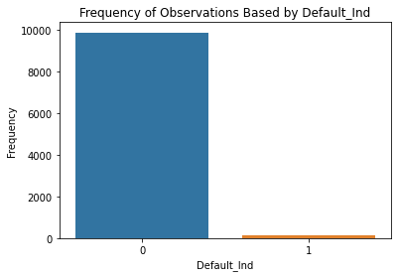
Default Indicator
Around 1.29% of Customers ARE in Default
There is a HUGE Imbalance in the number of Customers in Default or not

Slide 7
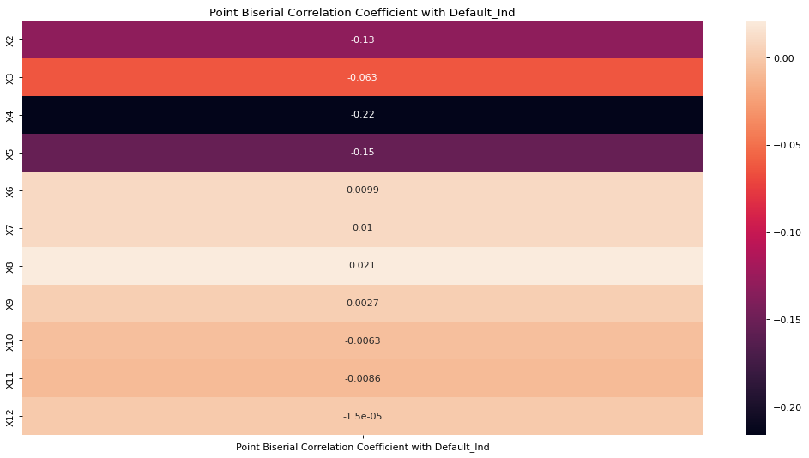
Point Biserial Correlation Between Continuous Features and Default Indicator
Point-biserial correlation to measure the strength and direction of the association between a continuous feature and Default Indicator
The HIGHER the coefficient, the STRONGER the relationship
The most correlated continuous features with Default Indicator are: X4, X5, X2, X3

Slide 8
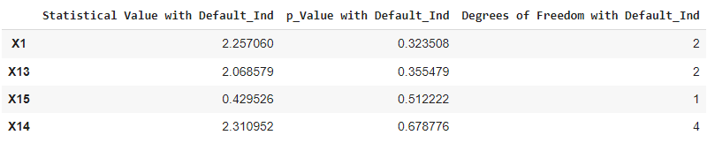
Chi-Square Test Between Categorical Features and Default Indicator
Chi-square test determines whether there is a relationship between a categorical feature and Default Indicator

Slide 9
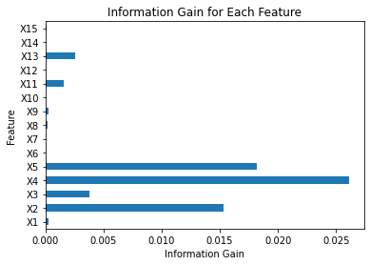
Information Gain Between Features and Default Indicator
Information Gain used to determine the best features/attributes that render mutual information about target variable Default Indicator
The top 4 features with the HIGHEST Information Gain are: X4, X5, X2, X3

Slide 10
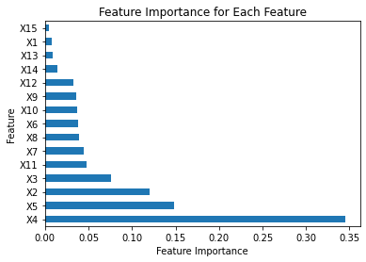
Feature Importance on Predicting Default Indicator
Feature importance refers to scores of input features based on how useful they are at predicting a target variable
Implemented Extra Decision Tree Classifier model to get feature importance
The most important features are: X4, X5, X2, X3

Slide 11
Data Preprocessing Steps
Split 70% of the data into training and remaining 30% into test/validation sets
Selected top 4 features (X4, X5, X2, X3) based on the collective results of Information Gain, Feature Importance, and both Point Biserial Correlation + Chi-Square Test
Implemented One-Hot Encoding (OHE) to convert categorical features into binary numerical columns for modelling
Implemented Standard Scaler to standardize/normalize the data to fit on the same scale

Slide 12
Creating a BASELINE Approach
For each machine learning classifier/algorithm:
Implemented a baseline model utilizing ALL of the features (X1 to X15)
Followed the Data Preprocessing Steps (except Feature Engineering section)
Implemented Grid Search CV to find optimal values for specific hyperparameters in each machine learning classifier/algorithm using 10-fold Stratified Cross Validation
Inputted the optimal hyperparameters into the baseline model
Model evaluation using F1-score and classification report
Plotted a confusion matrix

Slide 13
Feature Engineering Approach
For each machine learning classifier/algorithm:
Followed the same steps as in the Baseline Approach
Only difference here is choosing the top K features for model performance and evaluation
Chose top 4 features based on the collective results of Information Gain, Feature Importance, and both Point Biserial Correlation + Chi-Square Test

Slide 14
Machine Learning Classifiers Used
The machine learning classifiers used for comparison are:
Logistic Regression
Decision Tree Classifier
Support Vector Classifier
K-Nearest Neighbors Classifier
Random Forest Classifier
XG-Boost Classifier

Slide 15
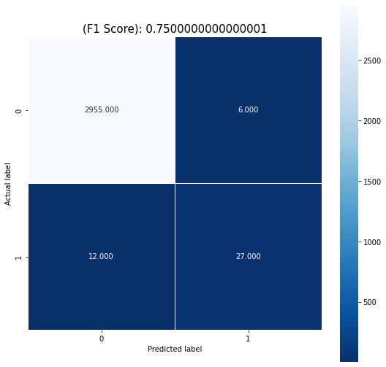

Logistic Regression
ALL Features
Top K=4 Features

Slide 16
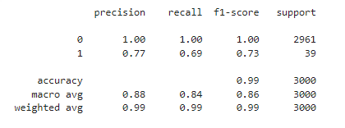
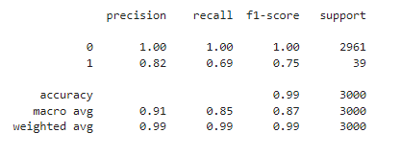
Logistic Regression
ALL Features
Top K=4 Features

Slide 17

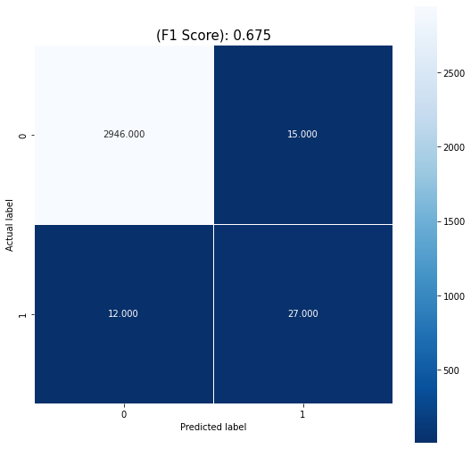
Decision Tree Classifier
ALL Features
Top K=4 Features

Slide 18
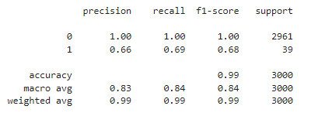
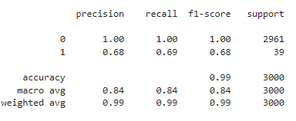
Decision Tree Classifier
ALL Features
Top K=4 Features

Slide 19


Support Vector Classifier
ALL Features
Top K=4 Features

Slide 20
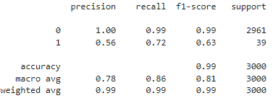
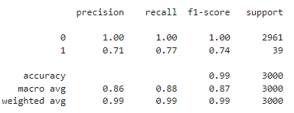
Support Vector Classifier
ALL Features
Top K=4 Features

Slide 21
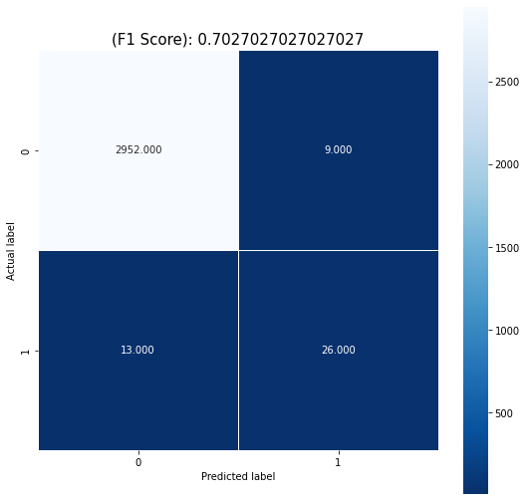

K-Nearest Neighbors Classifier
ALL Features
Top K=4 Features

Slide 22
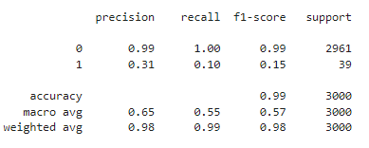
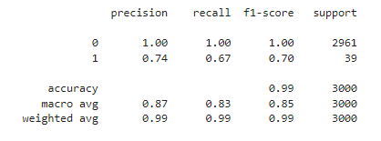
K-Nearest Neighbors Classifier
ALL Features
Top K=4 Features

Slide 23


Random Forest Classifier
ALL Features
Top K=4 Features

Slide 24
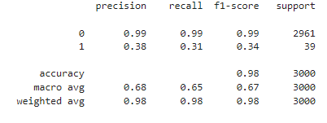
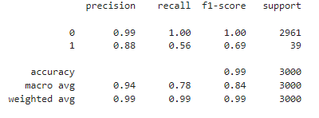
Random Forest Classifier
ALL Features
Top K=4 Features

Slide 25


XG-Boost Classifier
ALL Features
Top K=4 Features

Slide 26
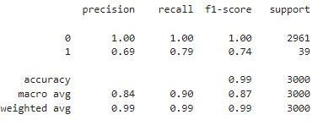
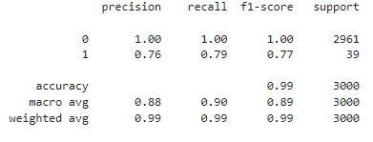
XG-Boost Classifier
ALL Features
Top K=4 Features

Slide 27
Conclusion
The top 4 features X4, X5, X2, X3 are the MOST influential in the model output Default Indicator
Surprisingly, the categorical features X1, X13, X14, X15 seem to have the least importance based on the Feature Importance scores
For all machine learning classifier, reducing number of features ALWAYS increased F1-score and Accuracy
The XG-Boost Classifier has the HIGHEST F1-score followed closely by Logistic Regression (or vice versa)

Slide 28
Improvements that can be Made
Some suggestions to improve model performance:
Thinking about how PD Risk Rating column/feature can assist in model performance
Try using 5-fold cross validation on different combinations of train and test set to find average F1-score for a specific classifier
Try over/under sampling to solve class imbalance problem of target variable Default Indicator
Think about utilizing some possible advanced feature selection techniques such as wrapper methods (Stepwise selection, Recursive Feature Elimination, etc.)

Slide 29


THANK YOU!

